Slide 1


Slide 2
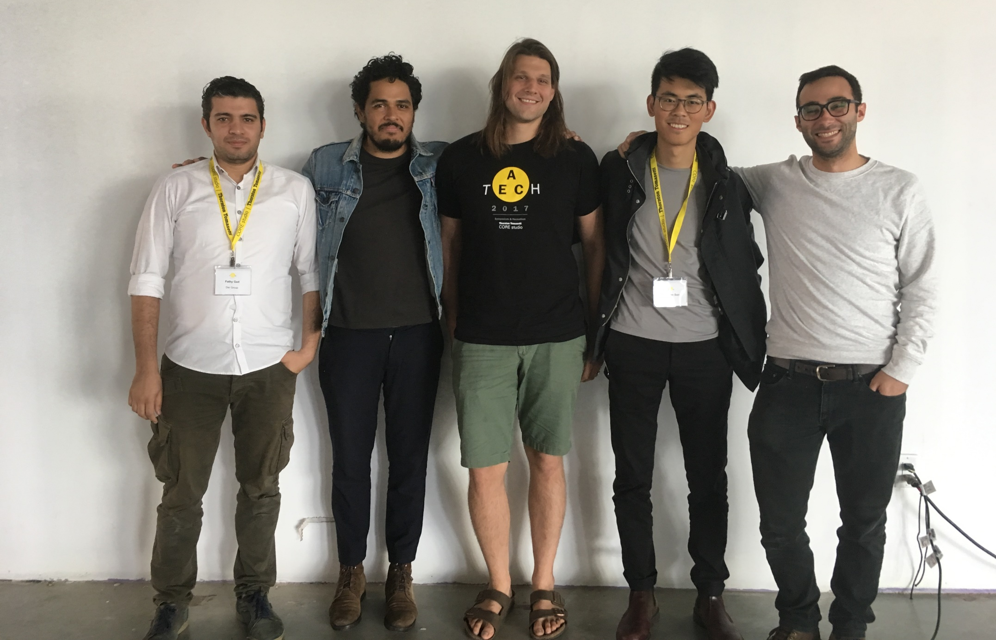
FATHY GAD
DAR GROUP
HIRAM RODRIGUEZ
CORE STUDIO
MICHEL KERO
CORE STUIDO
HANSHEN SUN
OFFICE
LELAND CURTIS
SMITHGROUP JJR
REVILATIONS || AECHACKATHON 2017

Slide 3
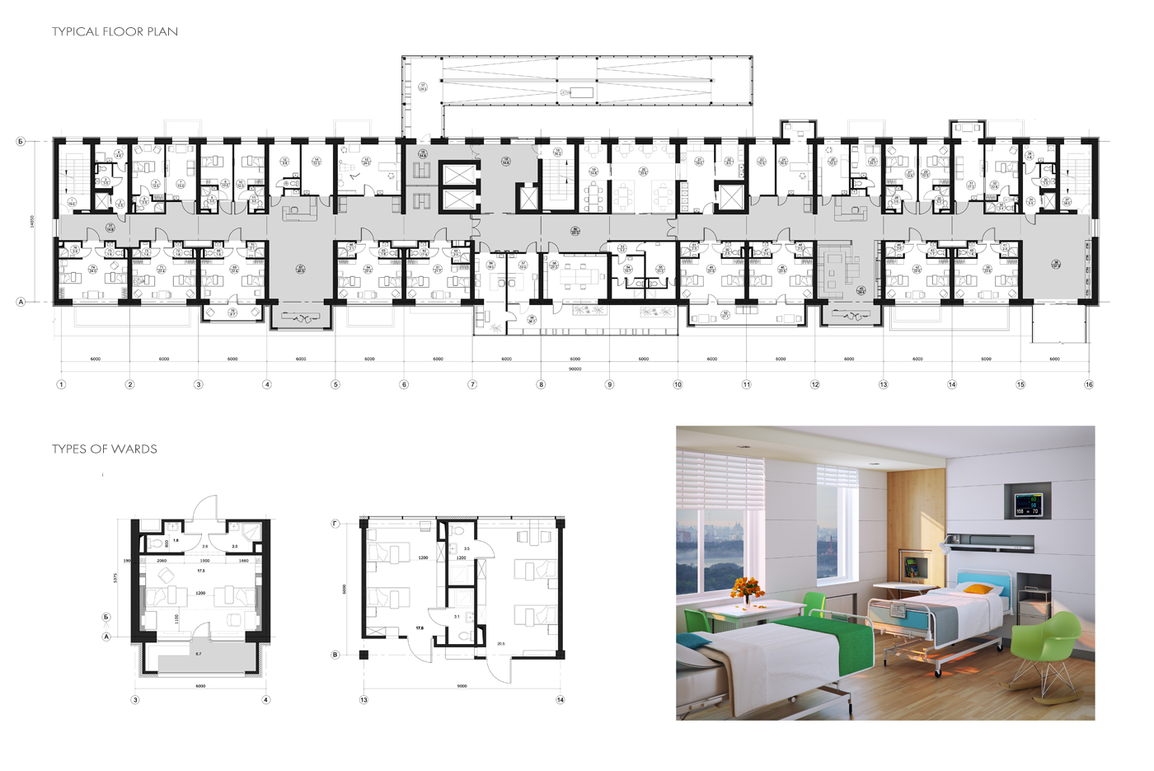
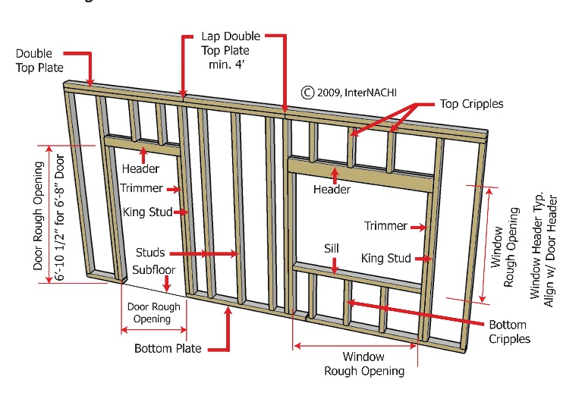

The Problem: Repetitive groups
REVILATIONS || AEC HACKATHON 2017

Slide 4
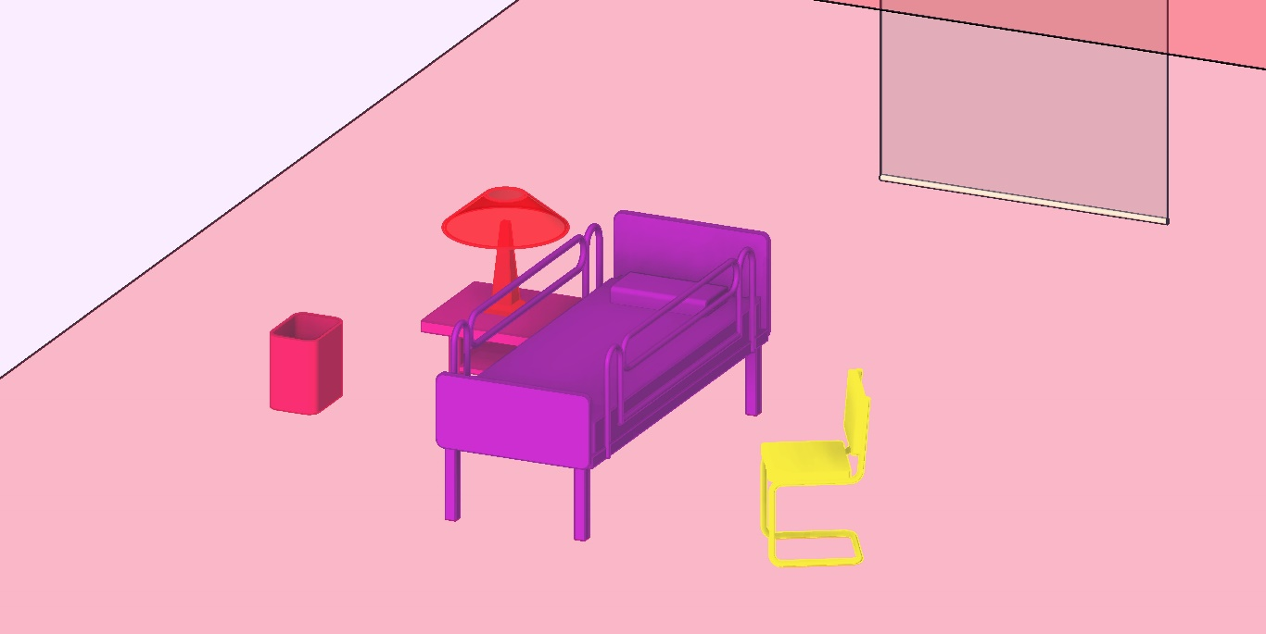
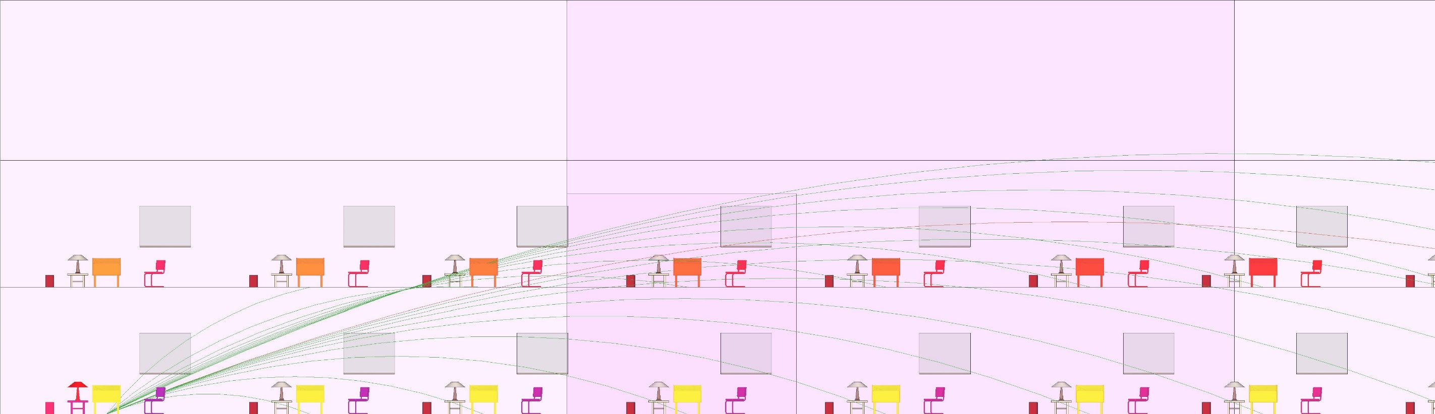
Set child-parent relationships
Automate placement + updating
REVILATIONS || AEC HACKATHON 2017

Slide 5
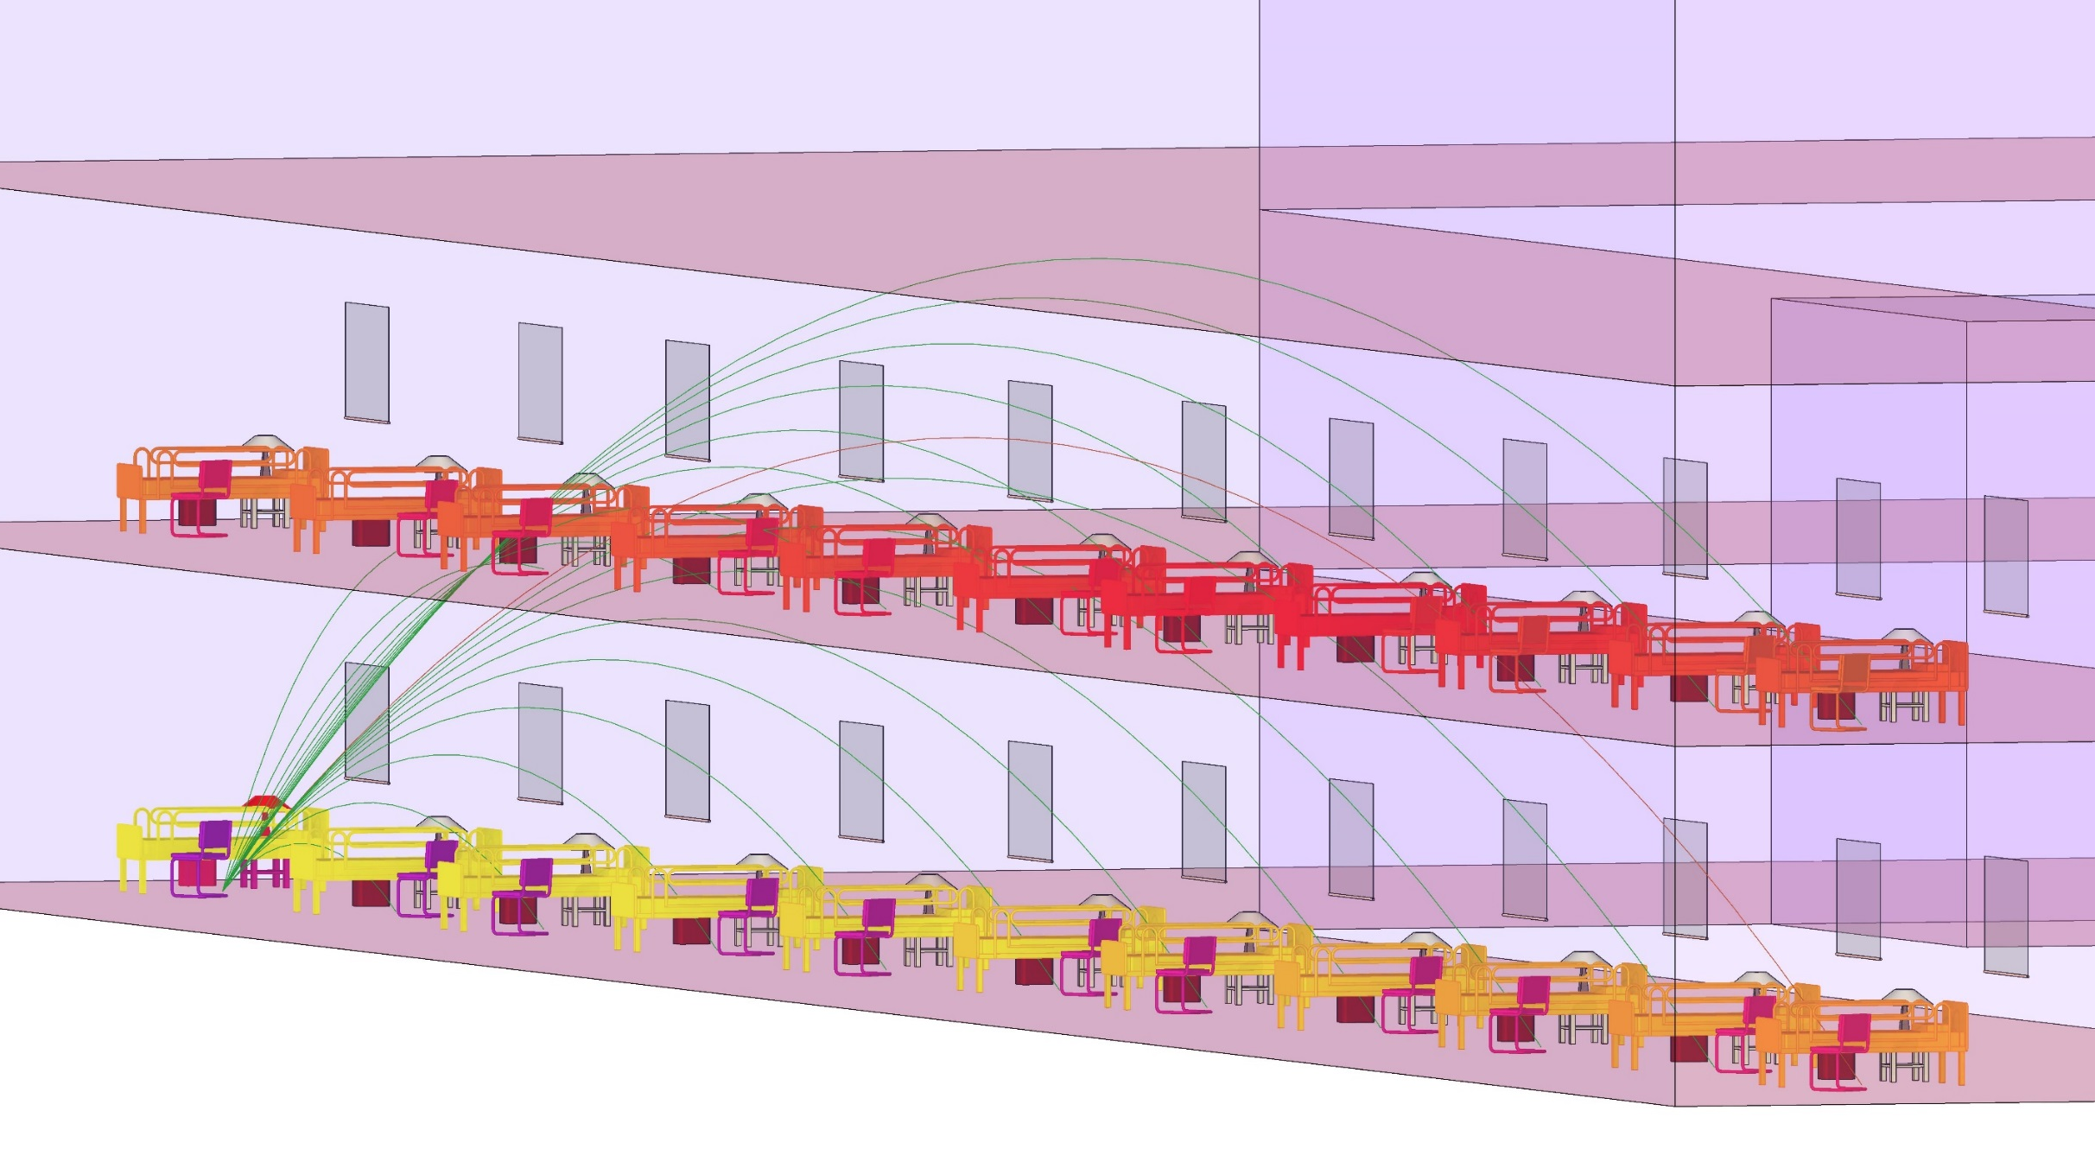
REVILATIONS || AEC HACKATHON 2017

Slide 6
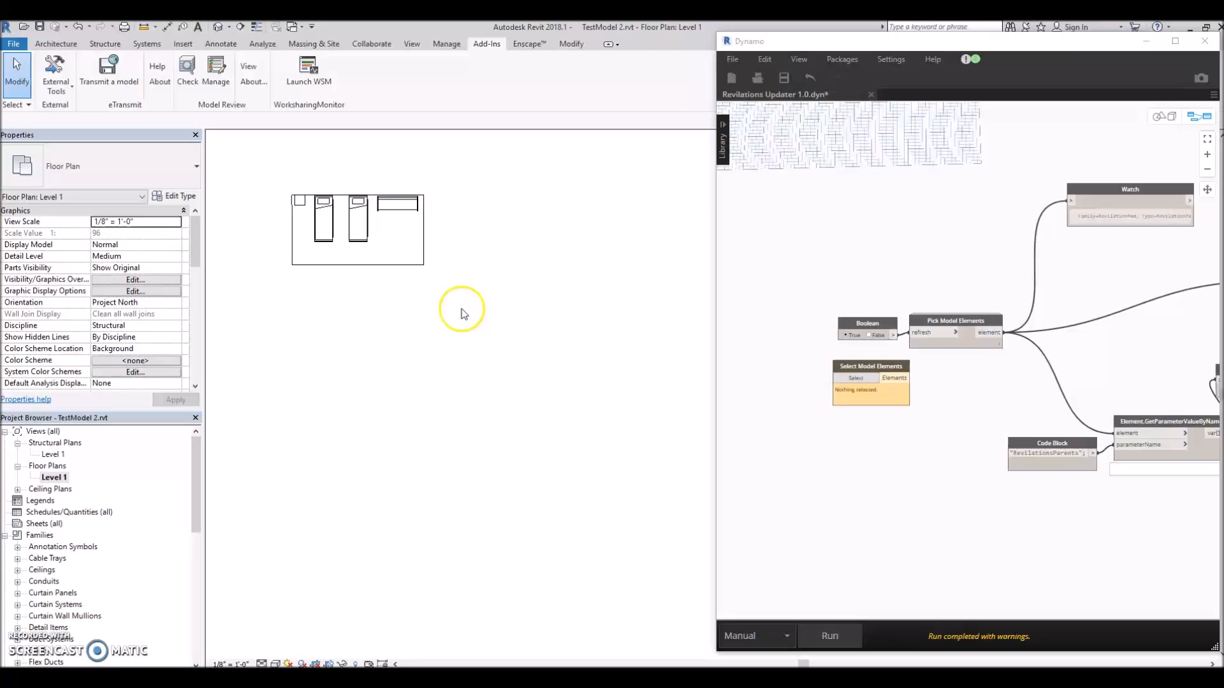
REVILATIONS || AEC HACKATHON 2017

Slide 7
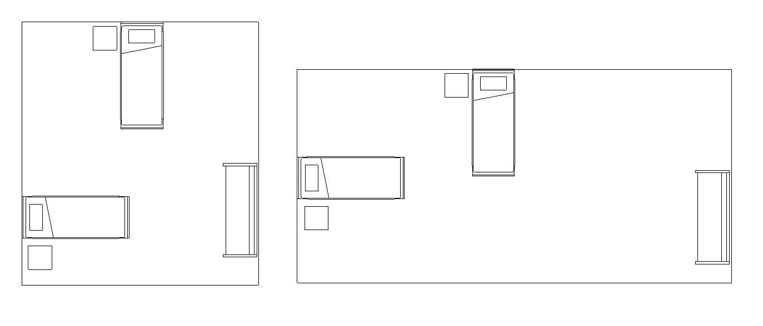
Enables smart guide plates
GUIDE PLATES
REVILATIONS || AEC HACKATHON 2017

Slide 8
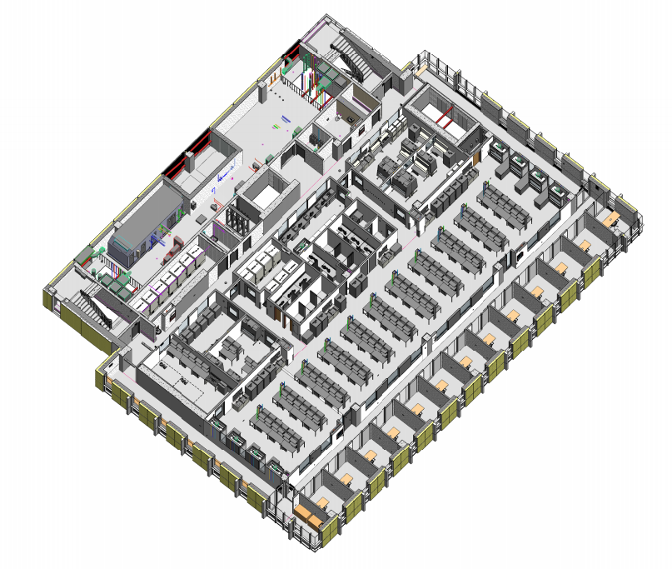
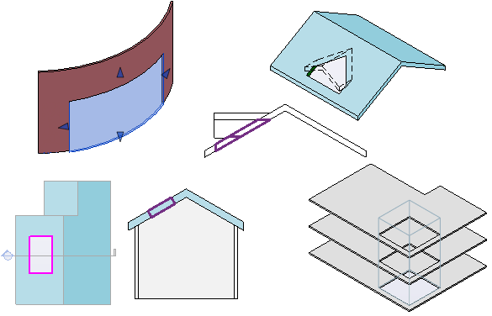
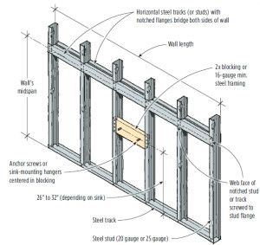
Parent-Child relationships are scalable
REVILATIONS || AEC HACKATHON 2017

Slide 9
Thank You
REVILATIONS || AEC HACKATHON 2017

